Slide 1
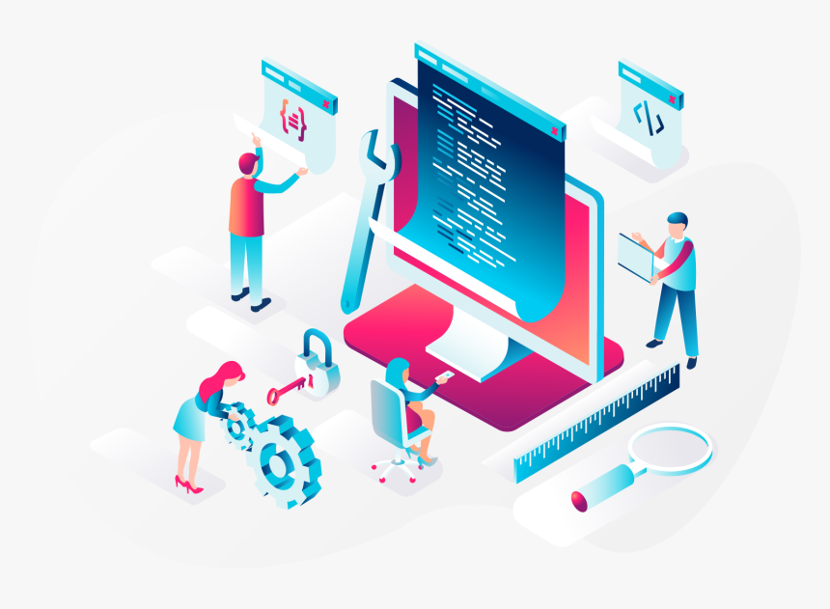
SE321
Lecture 1: Introduction
To Web Technology
SK. Fazlee Rabby
Lecturer
Department of Software Engineering
Daffodil International University

Slide 2
Software is a collection of instructions that
enable the user to interact with a computer, its hardware, or perform tasks
Software Engineering
Engineering on the other hand, is all about developing products, using well-defined, scientific principles and methods

Slide 3
What is Software Engineering Web Application
Software Engineering is the systematic application of scientific and technological knowledge, methods, and experience to the analyze, design, implementation, testing, and documentation of software that meets the user requirements.
Software Engineering Web Application is the systematic and quantifiable approaches to cost-effective analysis, design, implementation, testing, operation, and maintenance of high-quality Web applications.

Slide 4
Why Software Engineering Web Application

Slide 5
Why Software Engineering Web Application
As the reliance on larger and more complex Web Applications increases so does the need for using methodologies/standards/best practice guidelines to develop applications that are delivered on time, within budget, have a high level of quality and are easy to maintain. That is where comes software engineering in building quality web applications

Slide 6
Why Software Engineering Web Application
As the reliance on larger and more complex Web Applications increases so does the need for using methodologies/standards/best practice guidelines to develop applications that are delivered on time, within budget, have a high level of quality and are easy to maintain. That is where comes software engineering in building quality web applications

Slide 7
Web VS Internet
The internet is a massive network of networks, a networking infrastructure. It connects millions of computers together globally, forming a network in which any computer can communicate with any other computer as long as they are both connected to the internet.
The World Wide Web or simply web, is a way of accessing information over the medium of the internet. It is an information-sharing model that is built on top of the internet. That uses HTTP protocol, only one of the languages spoken over the internet, to transmit data of information to the users.

Slide 8


Web VS Internet
WEB
WEB
WEB

Slide 9


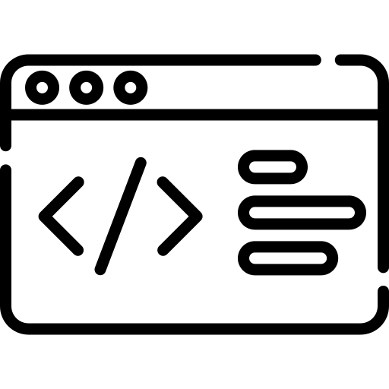
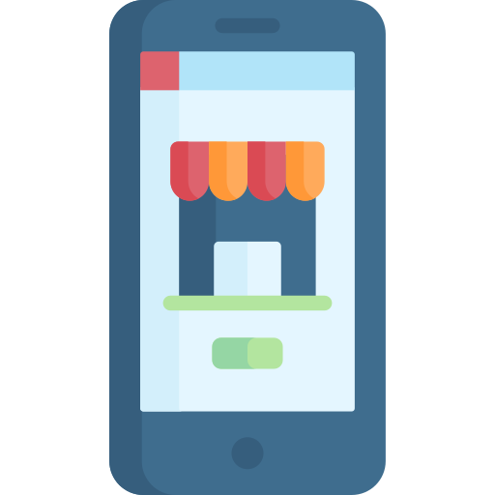



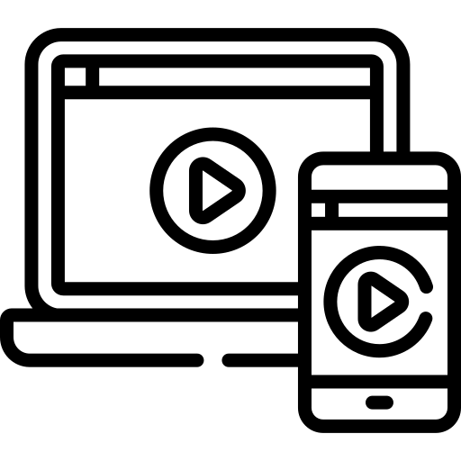
1989
Tim Berner’s Lee invents the World Wide Web
1990
Tim Berner’s Lee develops HTML, URI & HTTP
1991
The first website is launched
Mid 2000s
Adaption of Mobile phone take holds
1998
Google Officially Launches !
1996
Cascading Style Sheets are Released
2007
Mobile Safari Launches as the First mobile Web Browser
2007
Mobile Safari Launches as the First mobile Web Browser
2015
Google Sets mobile friendly deadline

Slide 10

GUESS WHO?
TIM BERNERS-LEE
WORLD’S FIRST WEBSITE

Slide 11
Protocol
Protocol is a standard set of rules that allow electronic devices to communicate with each other
File Transfer Protocol (FTP) – FTP is one of the most commonly used file transfer protocol on the internet and within private networks.
Simple Main Transfer Protocol (SMTP) – SMTP is used for primarily two functions. It is used to transfer email from source to destination between mail servers and it is used by end users to send mail to a mail system.

Slide 12
Hyper Text Transfer Protocol
Before the Web, the Internet protocol was FTP (File Transfer Protocol). FTP was too slow, and hence HTTP was invented.
HTTP takes care of the communication between a web server and a web browser.
HTTP is used for sending requests from a web client (a browser) to a web server, returning web content (web pages) from the server back to the client.

Slide 13
Hyper Text Transfer Protocol
There are four messages within this protocol:
Connection: Establishes a connection between the client and the server
Request: Asks for a resource
Response: Delivers the resource
Close: Terminates the connection

Slide 14



Domain Name
What was the IP of that important website?
www.easyname.com
203.109.64.104
Domain names were invented to solve this problem. Now if you want to visit a website, then you don’t need to enter a long string of numbers. Instead, you can visit it by typing an easy to remember domain name in your browser’s address bar
Websites are typically situated in webservers that are identified on the web using IP Addresses.
Numbers like IP Address are harder for ordinary people to remember

Slide 15
Uniform Resource Locator (URL)
Is a URL the same as a domain name?

Slide 16
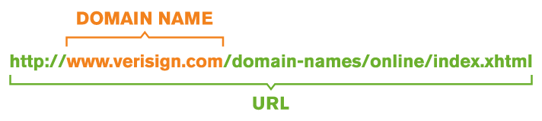
Uniform Resource Locator (URL)
Suppose I have requested one of you to collect a book from my home

Slide 17
Uniform Resource Locator (URL)
Domain Name is the Location of your home and URL is the exact location of the book you were searching for.

Slide 18
Attributes of Web Applications
1. Network Intensive | 4. Immediacy
2. Content Driven | 5. Security
3. Continuous Evolution | 6. Aesthetics

Slide 19
Attributes of Web Applications
Network Intensive
By Nature, a web application is network intensive meaning it resides on a network and must serve the needs of a diverse community of clients.
Web application may reside on the internet, intranet or extranet depending on the necessity of the application.
Internet: It is a global system of interconnected network where content in the network is accessible to everyone connected. It is a mean of sharing information throughout the world

Slide 20
Attributes of Web Applications
Network Intensive
Internet | Intranet | Extranet
It is a global system of interconnected network | It is a private network specific to an organization | It is a private network that uses public network to share information among multiple organizations
content in the network is accessible to everyone connected | Content in the network is accessible only to the members of the organization | Content in the network is accessible to members of the organizations & external members with access to the network
It is a mean of sharing information throughout the world | It is means of sharing sensitive information throughout organization | It is means of sharing information between members and external members

Slide 21
Attributes of Web Applications
Content Driven
The primary function of a WebApp is to use hypermedia to present text, graphics, audio, and video content to the end user.
Continuous Evolution
Web applications evolve continuously. It is not unusual for some Web Apps (specifically, their content) to be updated on an hourly schedule.

Slide 22
Attributes of Web Applications
Immediacy
Web-based applications have an immediacy that is not found in any other type of software. The time to market for a complete website can be a matter of a few days or weeks. Developers must use methods for planning, analysis, design, implementation, and testing that have been adapted to the compressed time schedules required for WebApp development
Security
Because Web Application are available via network access, it is very much important to protect sensitive content and provide secure modes of data transmission. Thus strong security measures must be implemented throughout the infrastructure

Slide 23
Attributes of Web Applications
Aesthetics
An undeniable part of the appeal of a Web Application is its look and feel. When an application has been designed to market or sell products or ideas, aesthetics may have as much to do with success as technical design.

Slide 24
Categories of Web Applications
1. Informational | 5. User Input
2. Download | 6. Transaction Oriented
3. Interaction | 7. Portal
4. Customizable

Slide 25
Categories of Web Applications
Category Name | Description
Informational | Read-only content is provided with simple navigation and links
Download | Downloadable information for users from the appropriate server
Interaction | Communication among a community of users occurs via chatroom, instant messaging
Customizable | The user customizes content to specific needs
User-Input | Forms-based input is the primary mechanism for communicating need.
Transaction-Oriented | The user makes a request (e.g., places an order) that is fulfilled by the Web Application
Portal | Web applications that provides users with a single access point to information from different sources

Slide 26
Attributes of a High-Quality Web Application
1. Usability | 4. Efficiency
2. Functionality | 5. Maintainability
3. Reliability | 6. Extensibility

Slide 27
Attributes of a High-Quality Web Application
Attributes Name | Description
Usability | Usability defines how well the application meets the requirements of the user and consumer by being intuitive, easy to localize and globalize, providing good access for disabled users, and resulting in a good overall user experience.
Functionality | Searching and retrieving capability, Navigation and browsing features, Application domain-related features
Reliability | Correct link processing, Error recovery, User input validation and recovery
Efficiency | Response time performance, Page generation speed, Graphics generation speed
Maintainability | Ease of Correction, Adaptability
Extensibility | System design must follow the principle where the implementation takes into consideration future growth. Extensions can be through the addition of new functionality or through modification of existing functionality

Slide 28
THANK YOU FOR
YOUR ATTENTION

